Slide 1
Research topics
David Cahen 12/’11
Hybrid molecular/non-molecular interfaces
* Do we really understand biological e⁻ transfer?
* Taming our work horse, Silicon
ALTERNATIVE ENERGY
Chemistry & Physics of Light → Electrical Energy conversion

Slide 2
Research topics
David Cahen 012/’11
Motivations
Understanding & Curiosity (“Everest” research) and…
… do we ask relevant questions?
Explore (bio) molecule-based electronics (with M. Sheves)
Use chemistry, (bio)physics & materials to improve
efficiency x lifetime) /cost of photovoltaic solar energy

Slide 3
Solar Cell Concepts and Materials
    Basic science towards improving
    (efficiency x lifetime) /cost of (any) solar cell
what are the real limits to PV energy conversion ?
Metal-Insulator-Semiconductor solar cells :
re-discovering Si
Mesoporous, nanocrystalline solid junctions →
→ high voltage solar cells (with G. Hodes)

Slide 4
Solar Cell Concepts and Materials
Molecules as
“door-men”
Back contact
Poly-xtline p-CdTe
V
Poly-xtline n-CdS
Conductive oxide
Effects of molecule adsorption
on solar cell performance
Glass
hν
Adsorbed molecule
CdTe
HOW IS THIS POSSIBLE ?
Adsorption at the PV junction - affects V_{OC} ! ! !
CdS

Slide 5
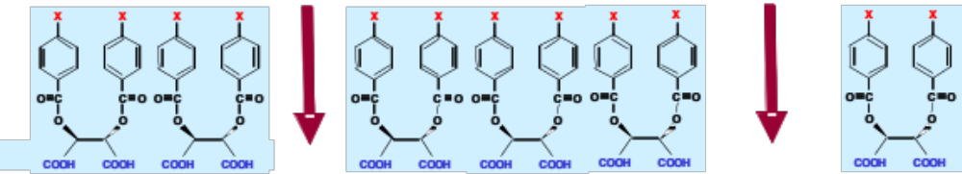
… because … of physics of dipole layers !
Molecules
SC
Pinholes
idealized
cartoon

Slide 6
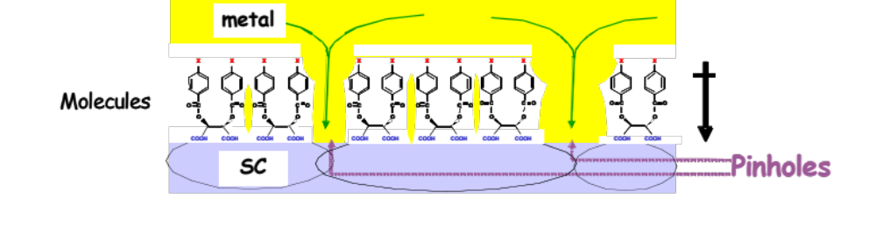
… because … of physics of dipole layers !
i.e., we can use even
discontinuous incomplete monolayers
idealized
cartoon
Even poorly organized monolayers can do,
but
need at least average orientation

Slide 7




Device Outline
with M. Bendikov, L. Kronik, R. Naaman
A. Kahn; N. Koch, F. Würthner
R = Dipole-forming Molecules
use
+
-
+
-
Metal Contact
~10 nm
Donor : Organic Light Absorber
or
~40 nm
R R R R R R R R R R R R R R R R R
l l l l l l l l l l l l l l l l l l
~1 nm
+
l
Monolayer: Trimethoxy Silane
+
l
+
l
+
l
∝Voc
Metal Contact
+
l
+
l
DONOR
ACCEPTOR

Slide 8
But first
….
Back to Basics

Slide 9
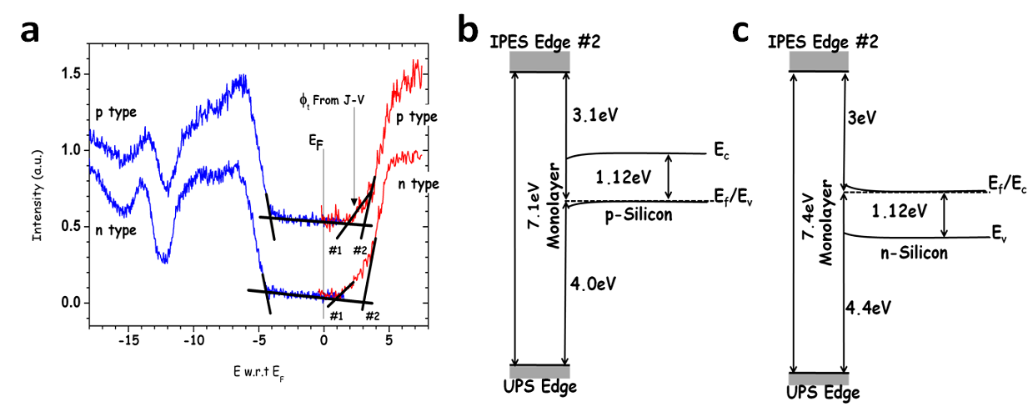
Energy Levels at Interfaces?

Slide 10
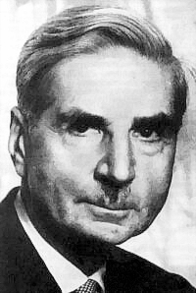
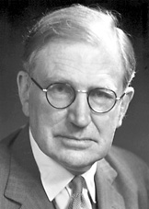

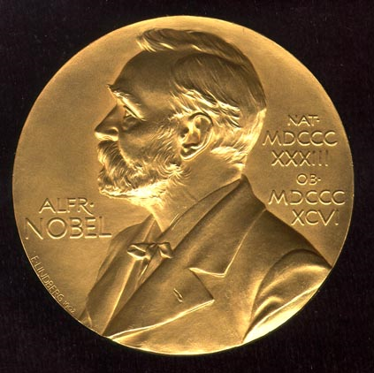
Metal / Semiconductor (MS) junctions according to Schottky & Mott
Metal
Semiconductor
Metal
Semiconductor
E_{L}
E_{L}
E_{L}
E_{L}
Schottky limit: φ_{b,n}=Φ_{m}-χ
Walter H. Schottky
χ_{SC}
Φ_{m}
Φ_{m}
χ_{SC}
E_{C}
φ_{b,n}
V_{bi}
E_{F}
E_{C}
E_{F}
E_{F}
E_{F}
E_{V}
E_{V}
Sir Nevill F. Mott

Slide 11
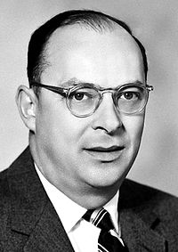
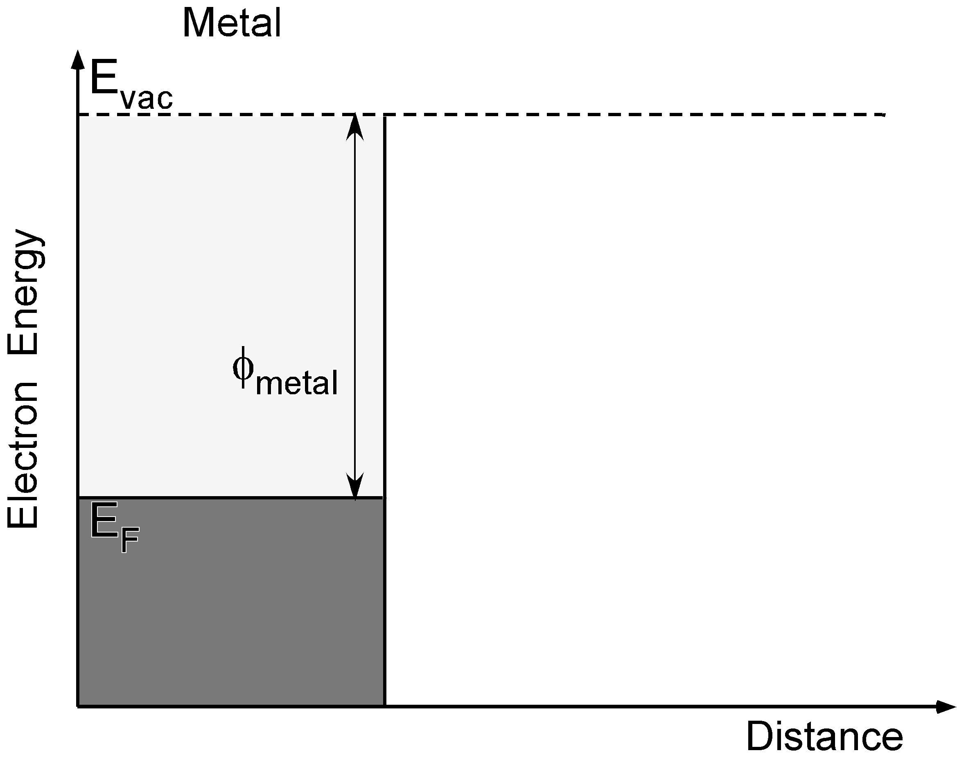
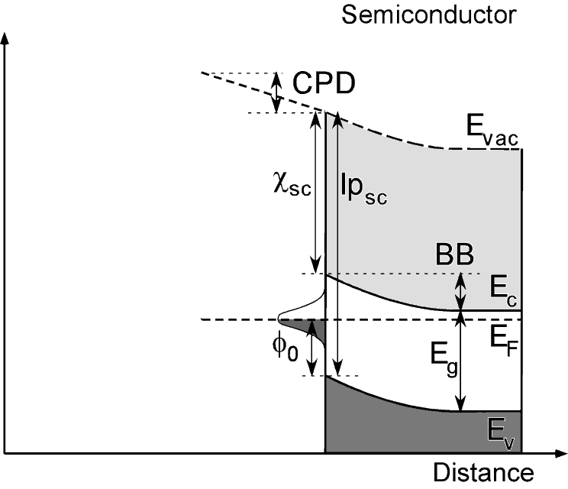
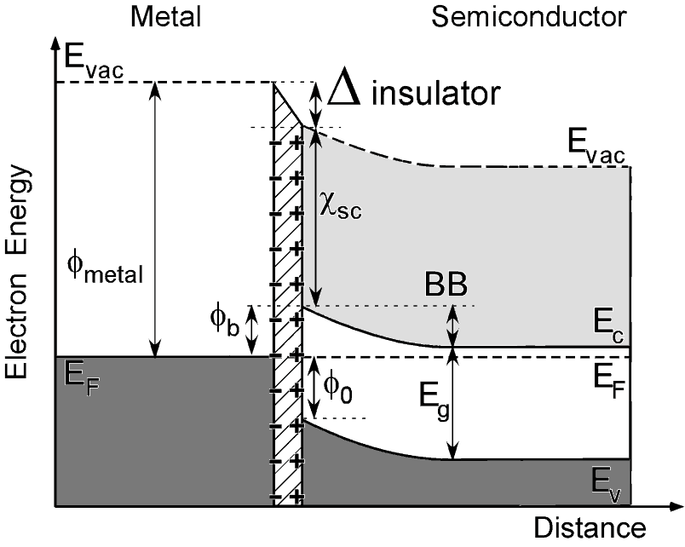
Fermi-Level Pinning (Bardeen Limit)
φ_{b}=E_{g}- φ₀
John Bardeen
Barrier dictated by Charge Neutrality Level, φ₀, of surface states
Δ Vacuum falls over interface → no change inside semiconductor → S = 0

Slide 12
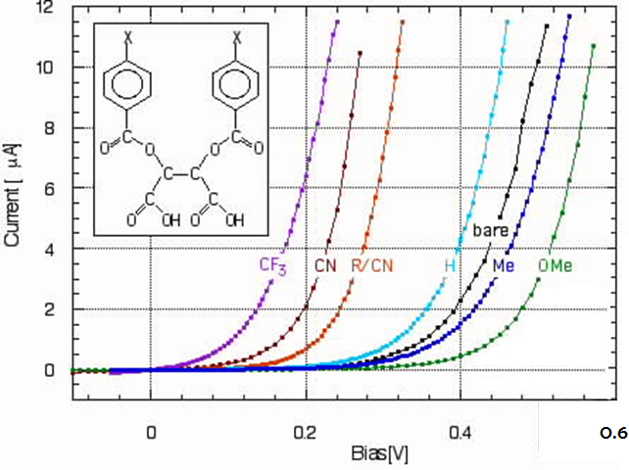
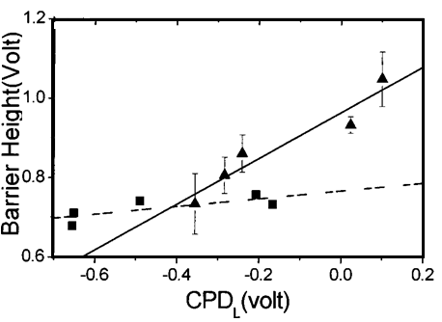
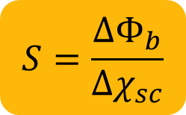
Previous Works: GaAs & ZnO
A. Vilan, A. Shanzer, D. Cahen, Nature, 404, 166 (2000)
Salomon, Berkovich, & Cahen,
Appl. Phys. Lett., 82, 1051 (2003)
ZnO
S~0.6
GaAs
S~0.1

Slide 13
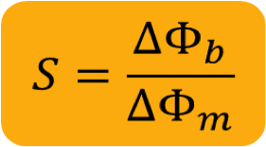
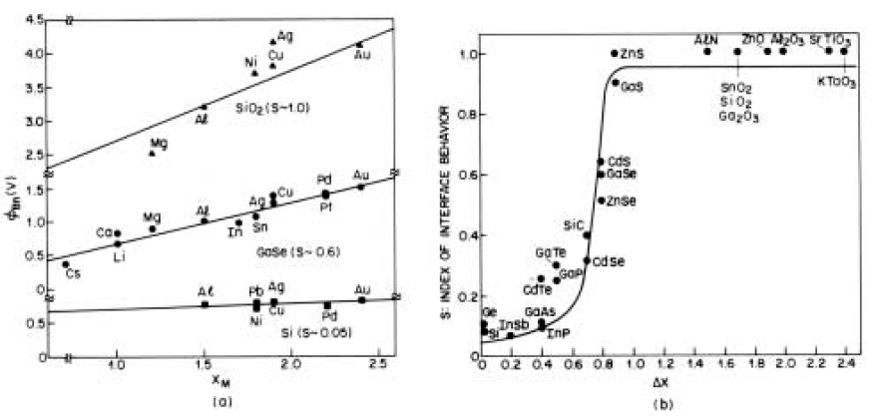


Index of Interface Behavior, S
SiO2; S ~1
φ_{b}=φ_{m}-χ_{sc}
GaSe; S ~0.6
⇓
φ_{b} ≈ φ_{m}+const.
Si; S ~0.05
Kurtin, McGill, Mead, Phys. Rev. Lett., 22, 1433, (1970)
L.J. Brillson. Surf. Sci. Rep., 2, 123, (1982)

Slide 14
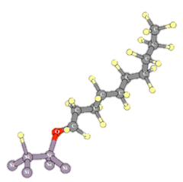
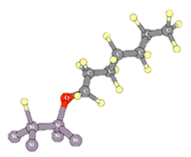
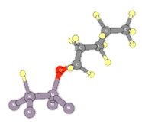
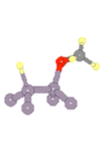
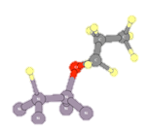





Need to revise textbooks!
HQ-alcohol
Si(100)
C1
C3
C5
C7
C10

Slide 15
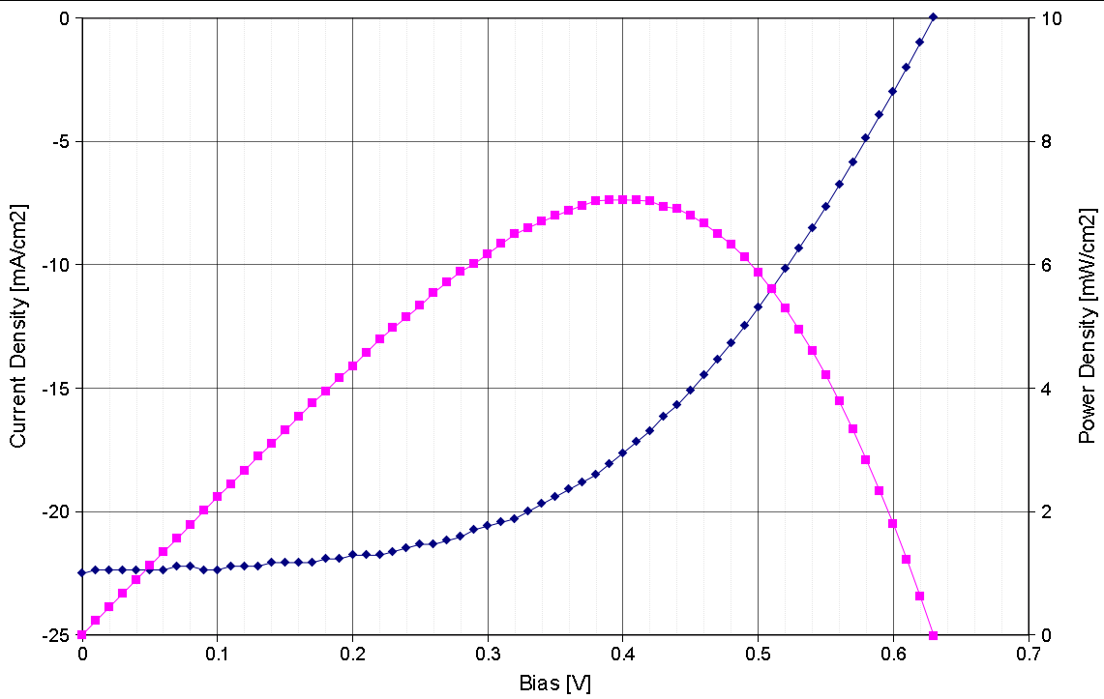
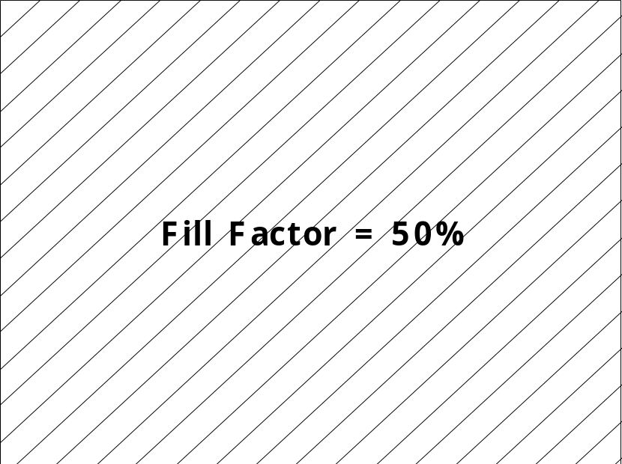
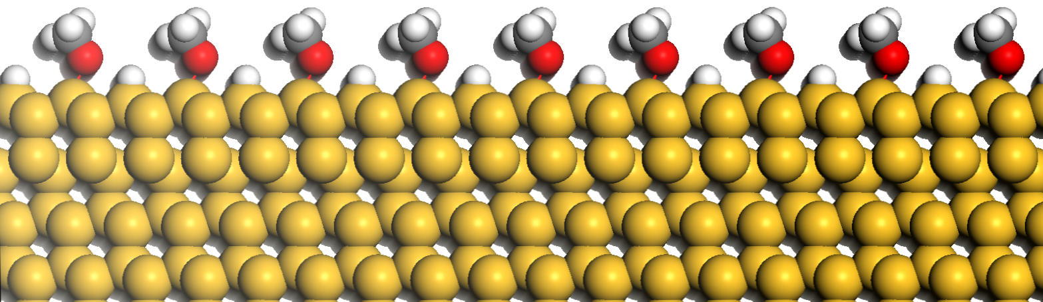
Solar Cell Result
7mm x 9mm cell, 1 mm grid spacing
~100 mW/cm² illumination.
Current Density [mA/cm²]
Power Density [mW/cm²]
PEDOT:PSS
n-Si

Slide 16
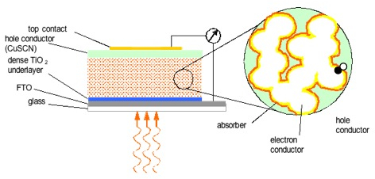
Solar Cell Concepts and Materials
Molecules in nano-porous, solid state solar cells?
Extremely Thin Absorber (ETA) cells
TiO₂,
ZnO
optical absorber
electron
conductor
hole
conductor
CuSCN
with G. HODES

Slide 17
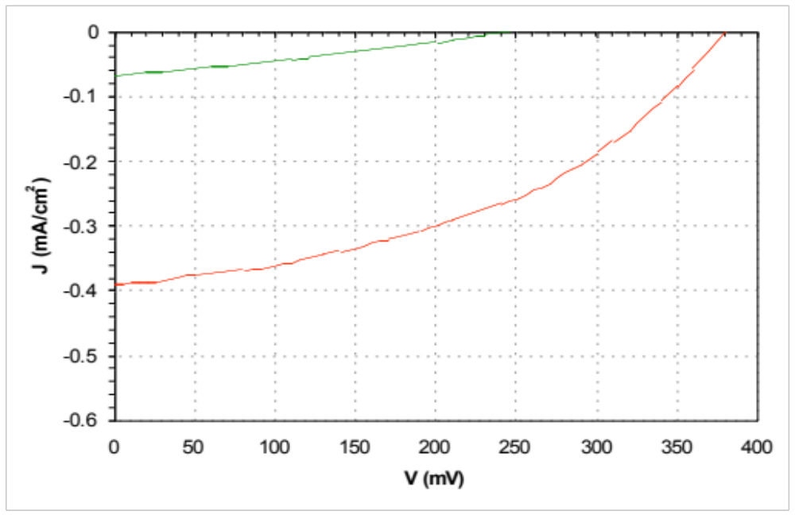
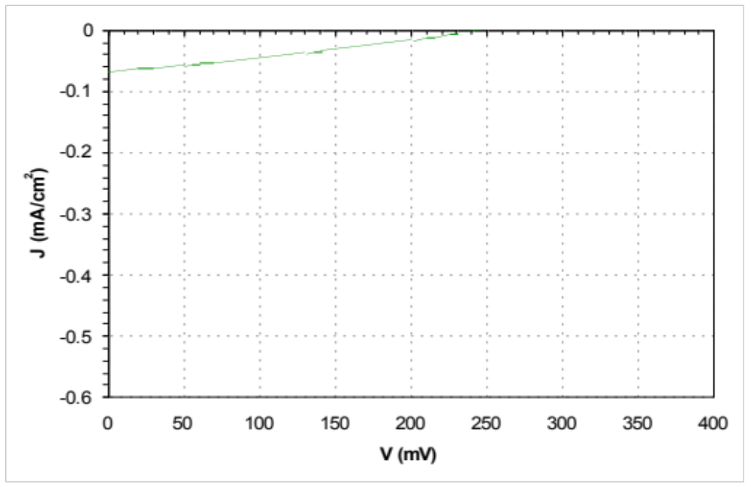
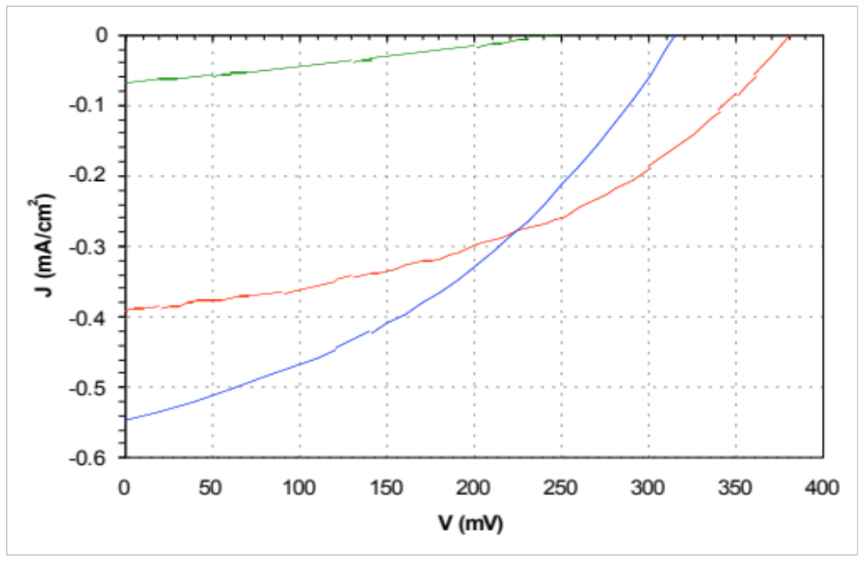
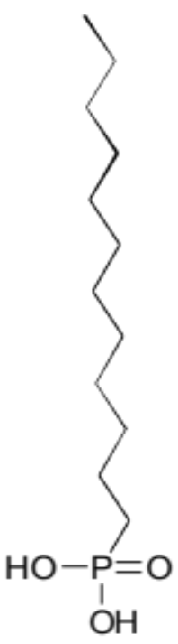
Cu_{2-x}S absorber PV performance:
Cu_{2-x}S absorber PV performance:
effect of buffer monolayer
Cu_{2-x}S absorber PV performance:
effect of alkyl monolayer
energy
Cu_{2-x}S
energy
electrons
electrons
E_{F}
holes
E_{F}
In_{x}(OH)_{y}S_{z} + Cu_{2-x}S
Cu_{2-x}S
holes
CuSCN
TiO₂
buffer
layer
distance
distance
In_{x}(OH)_{y}S_{z} + C₁₂-P(O)(OH)₂ + Cu_{2-x}S
with G. HODES

Slide 18
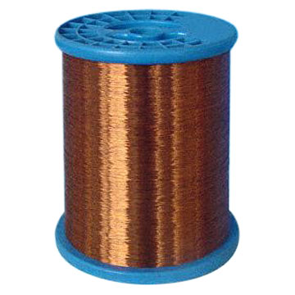
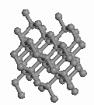
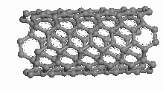
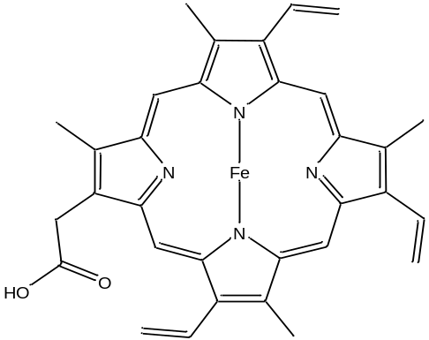
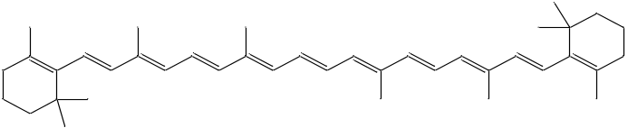
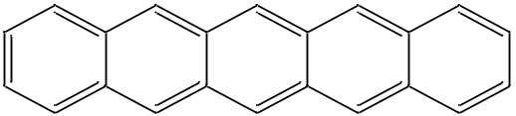
Which types of electronic conductors do we know ?
Silicon
Diamond
Carbon Nanotubes
semiconductors
Carbon
Cu
metals
β-Carotene
Pentacene
Bio-molecules?
Organic
(semi)conductors
Heme

Slide 19
Electronics with Bio-Molecules?
Force electrons through (bio)molecules;
What is/are transport mechanism(s)?
High quality
device structures
Transport
(yield, reproducibility)
Theory
Electronic structure
Models
Spectroscopy
electron, electrical
optical +++
Transport
mechanisms

Slide 20
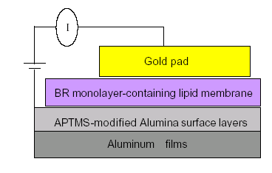
‘Dry’ Electronic Transport across surface-immobilized proteins
Bacteriorhodopsin (bR)
Azurin
BSA
OPEN QUESTIONS
What is / are the e-transport mechanism(s) ?
Can we make artificial systems, based on these?
with Sheves & Pecht

Slide 21
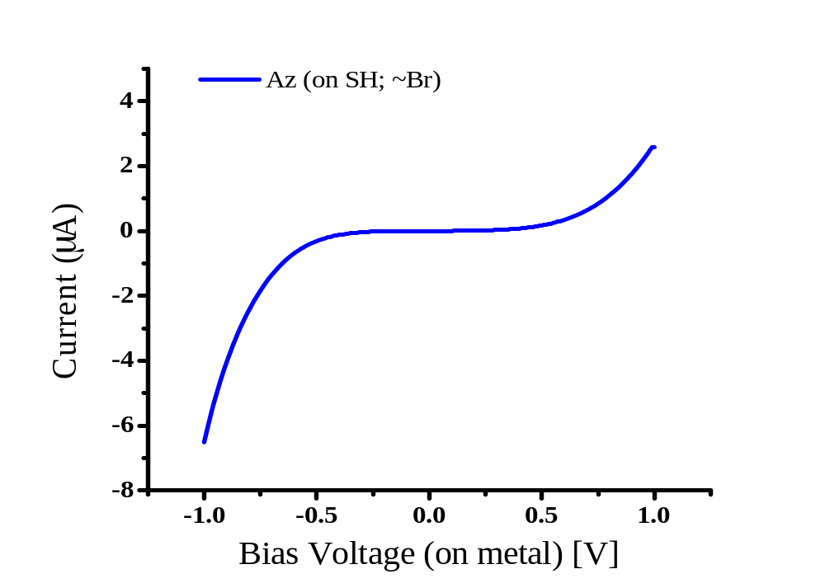
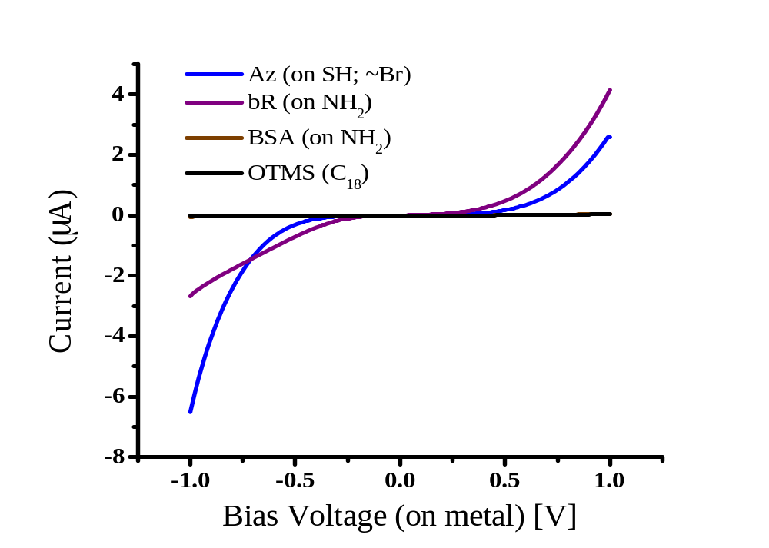
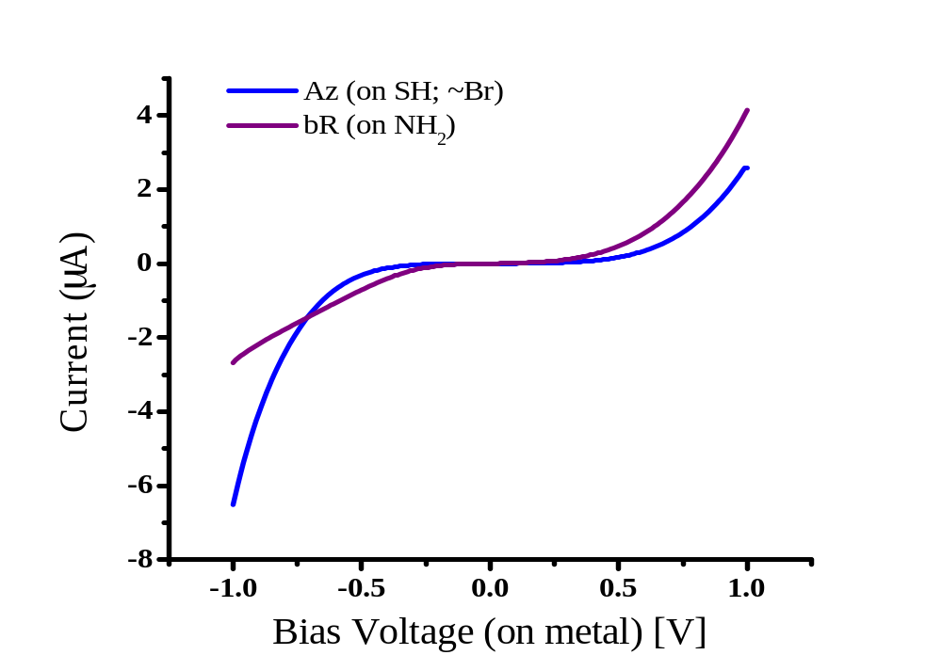
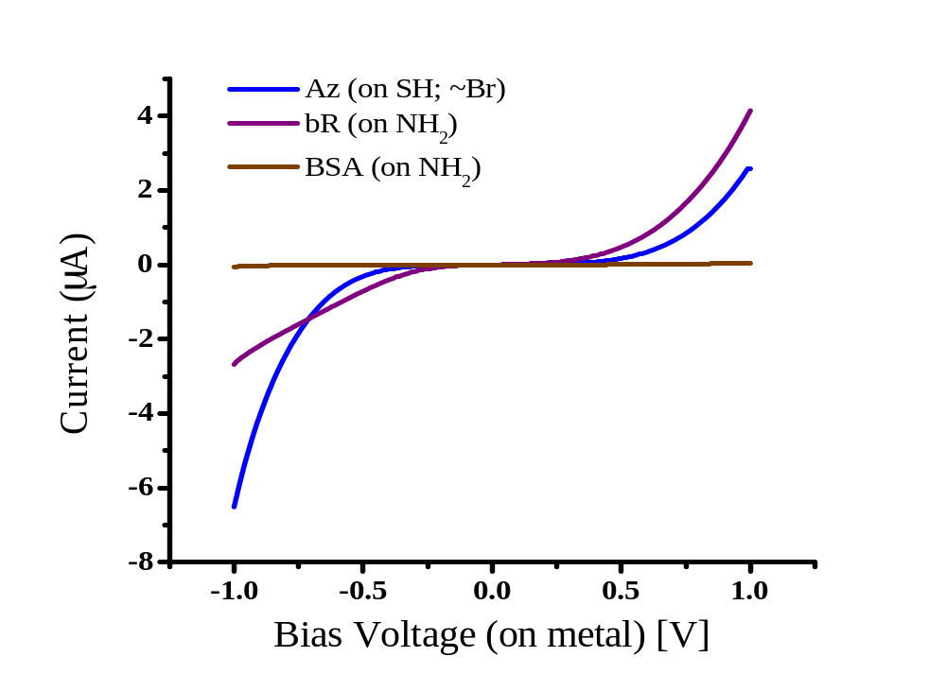
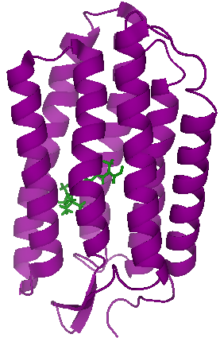
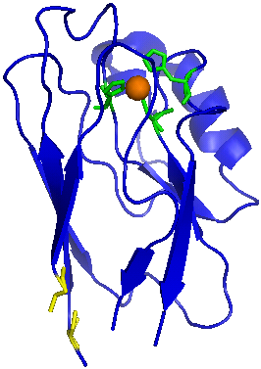
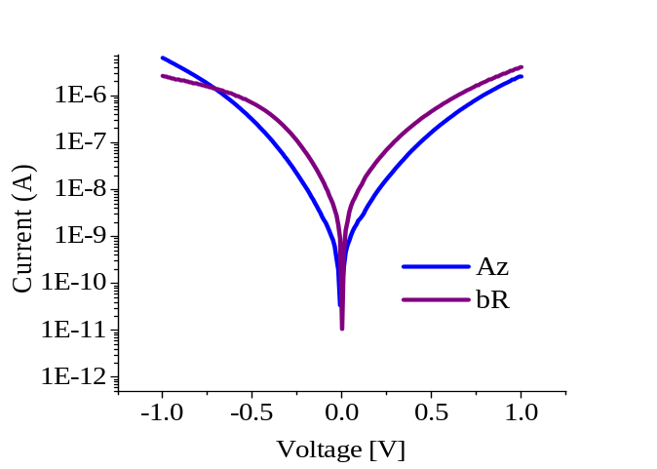
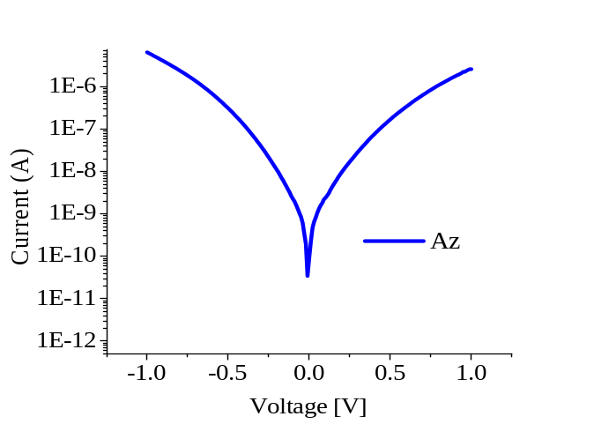
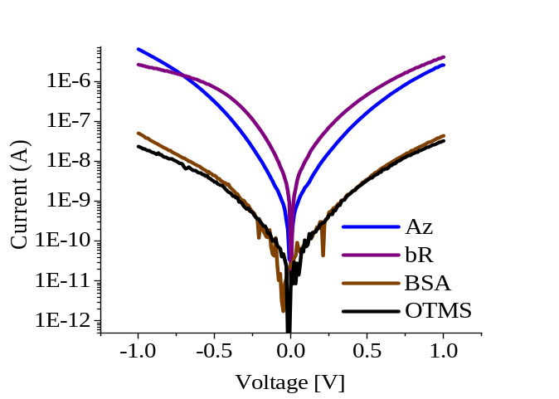
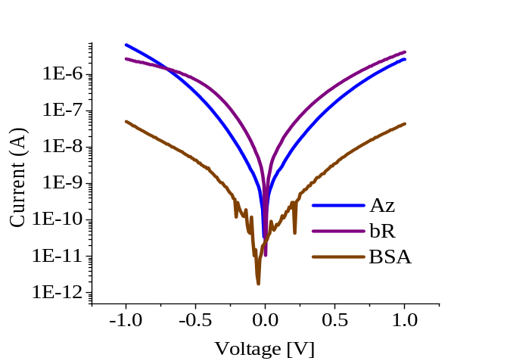
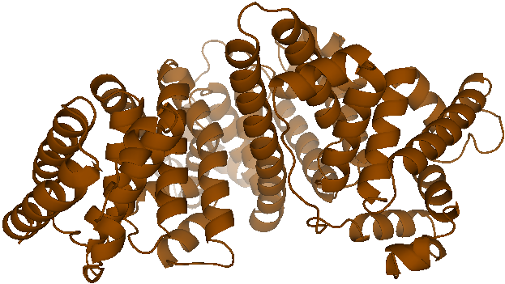

I-V characteristics
protein layers
Electrical top contact
Linker layer
Conductive substrate
Notes:
Shown are the mean currents (obtained by linear averaging) of 60 junctions from each protein type.
INSET- the same on a semi-log scale. bR and Az curves show opposite asymmetry. Az asymmetry was the same on either Br- or SH-terminated surfaces, although the I-Vs of the junctions with linkers alone had different asymmetries. Therefore, this can be seen as a molecular signature of the protein.
Az and bR attenuate the current per junction by ~3 orders of magnitude. BSA, as can be clearly seen in the semi log plot, is another 2 orders of magnitudes lower. For currents as those measured through BSA, for example, to be the result of tunneling through free space in possible pinholes in the monolayer, the spacing between the two electrodes should be 5.5 Å, across all the junction geometrical area, assuming β=2 Å⁻¹ for free space. Therefore, we argue that ETp takes place exclusively through the protein medium.
(on SH)
(on NH₂)

Slide 22
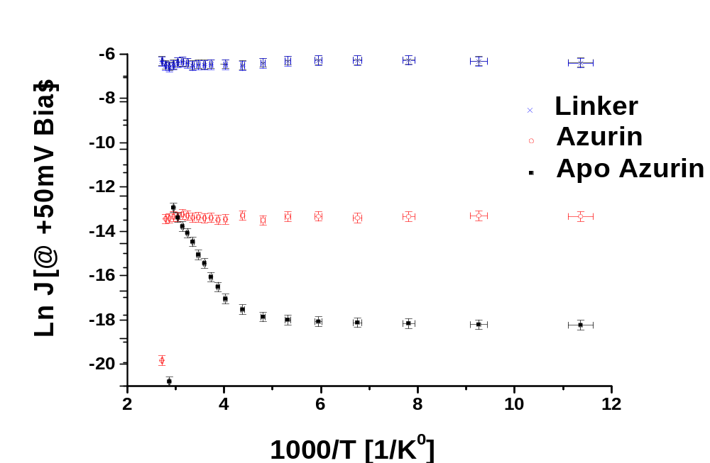
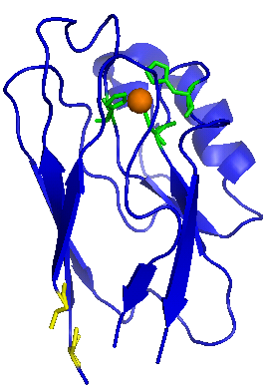
Striking temperature effects
3.5 nm
Electrical top contact
Linker layer
Conductive substrate

Slide 23
OPEN QUESTIONS
Basic limits to solar light conversion / solar cells
→ Understand static and dynamic disorder effects
→ Tailor solar cells with molecules
The inorganic/organic interface, the next frontier?
Hot electron injection?
Why is Electron Transport across proteins so efficient ?
Study Peptides
Use also CP-AFM
Use also Electrochemistry
Study effects of biological function (e.g., CO/O₂ on myoglobin)
Further cooperation/collaboration in WIS with:
O. Tal, R. Naaman, I. Lubomirsky, S. Cohen, H. Cohen
in Israel N. Tessler, A. Zaban, C. Sukenik, A. Nitzan, N. Ashkenasy
Abroad: USA, Japan, Germany, Italy, France, Spain
Notes:
To conclude I show you that transport through alkyl chains can be described in a first order approximation as tunneling through a dielectric system.
However we have to remember that molecules are differ from non-molecular mesoscopic systems.
And as fynmann said that in bio systems can be understood by fact that the atoms are jiggling and wiggling
Also here we should not forget that this is a living system and the molecules are jiggling and wiggling.
That’s why tunneling through them depends on temperature.
And maybe the small effective mass we got for that system reflects it.

